Slide 1
Content Management System
Created By-
Vaibhav Jain

Slide 2

Aim
The aim of my website is to present the user an interactive and hassle free way to order books online and also to provide them with an option to read E-books for a hourly rate.

Slide 3

Benefits
It saves the user time and effort to go and search for various other websites for different content and get all the things they need in one place.
It gives the user additional discounts which they won’t get on other sites.
It helps the user to get the book they need through home delivery system.

Slide 4
Highlights
My website home page covers most of the content so the user does not have to go to different tabs to know about the different features which saves him lot of time and makes it easy to browse the website.
It has collaboration with various other websites which provide their services to us and we help to advertise them in return.
It has both the feature to read a book online as well as order it for specific period of time.

Slide 5
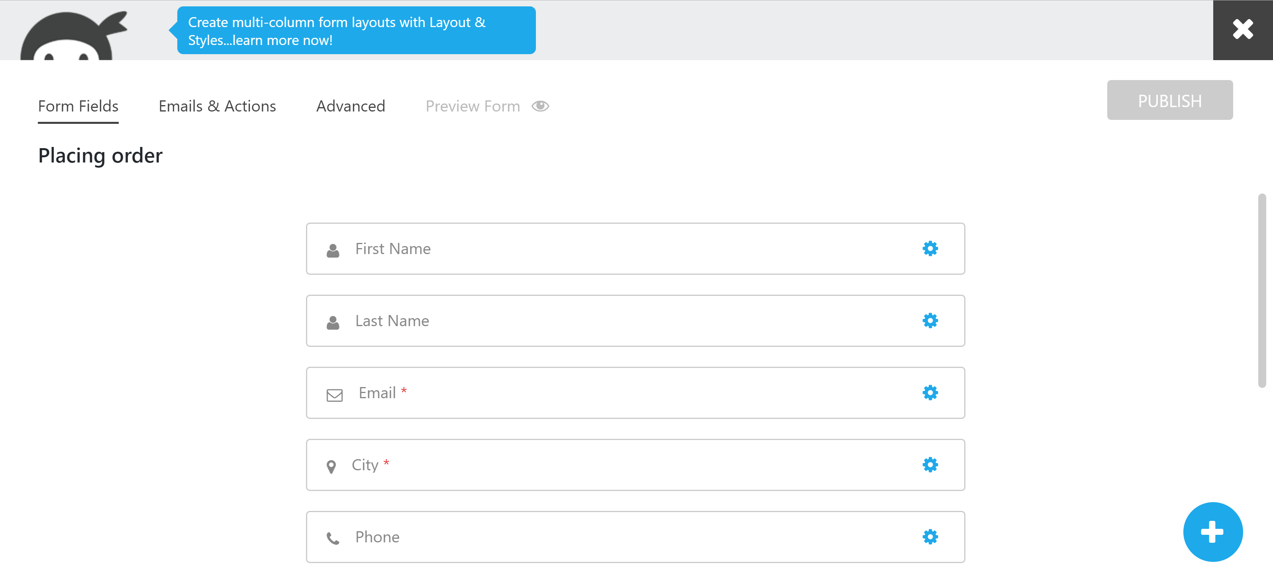
Plugins/extensions
I have used ninja forms to add a order form to the website, it was very easy to use and also user friendly and provide the option to develop a form from the scratch and also gives out templates to make our work easier.

Slide 6
Hosting
I have used Sitegrounds.com for hosting the website online and used the Wordpress/Joomlakit for publishing the website online which taught me a lot about publishing the website online and gave me experience on how to properly manage a website.

Slide 7
Coding
I have used the basic html coding for my website and didn’t go into hard coding stuff, my focus was to organize the website in a nice and representable manner and to do away with unnecessary coding and styling of the matter on my website.

Slide 8
Thank you for your time

